Slide 1
Is there a framework that can help me to operationalize strategy into actions and can monitor the progress or effectiveness of the strategy?

Slide 2
Balanced scorecard (BSC) Framework
(Framework given by Robert S. Kaplan and David P. Norton)

Slide 3
The system/framework connects the dots between big picture strategy elements such as mission (our purpose), vision (what we aspire for), core values (what we believe in), strategy and the more operational elements such as:
- strategic objectives (continuous improvement activities),
- measures (or key performance indicators (KPIs), which track strategic performance),
- targets, (our desired level of performance)
- initiatives (projects that help you reach your targets)
Balanced scorecard (BSC) Framework

Slide 4
Viewing and Measuring Performance
Balanced scorecard– View and measures the performance from multiple perspectives:
Financial Perspective
Customer Perspective
Internal business process perspective
Innovation and learning perspective/Organizational capacity
The balanced scorecard suggests that we view the organization from four perspectives, and to develop metrics, collect data and analyze it relative to each of these perspectives:

Slide 5
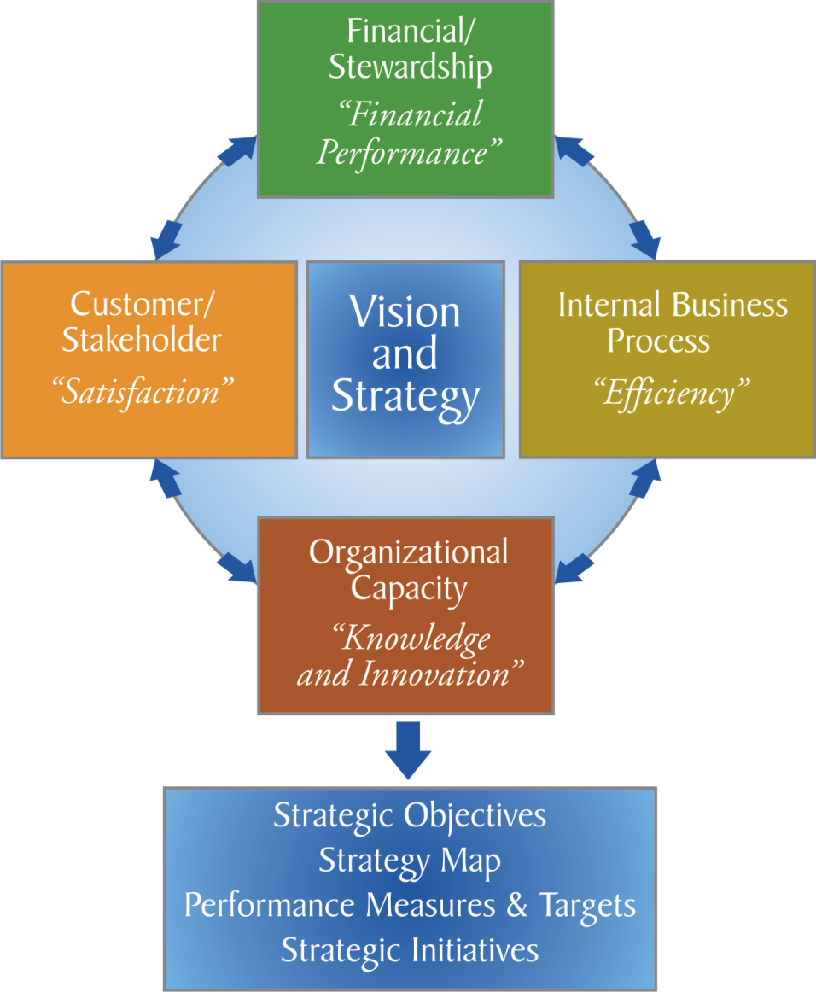
Balanced scorecard

Slide 6
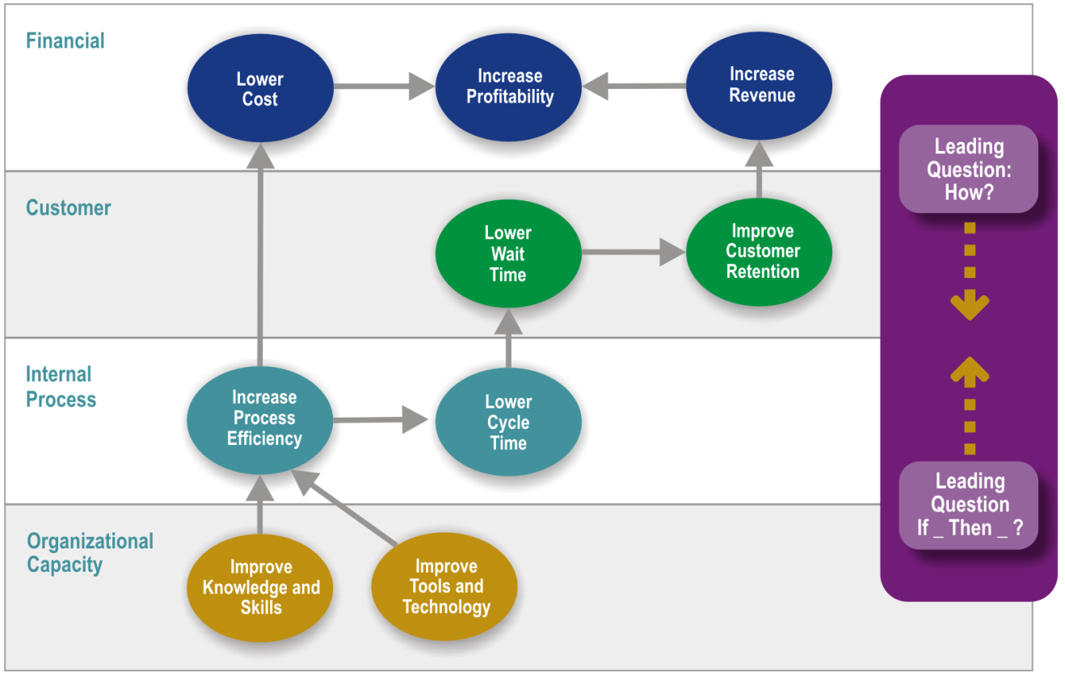
Strategy Map

Slide 7
Strategy Maps
Strategy maps are communication tools used to tell a story of how value is created for the organization. They show a logical, step-by-step connection between strategic objectives in the form of a cause-and-effect chain.
Improving performance in the objectives found in the Learning & Growth perspective enables the organization to improve its Internal Process perspective Objectives, which in turn enables the organization to create desirable results in the Customer and Financial perspectives

Slide 8
Strategy Map
Mission/Vision/Values/Strategy
Perspective | Strategic Objectives | Measures / Key performance indicators (KPIs) | Targets | Initiative
Financial
Customer
Internal Process
Organizational Learning & Growth/Organizational Capacity

Slide 9
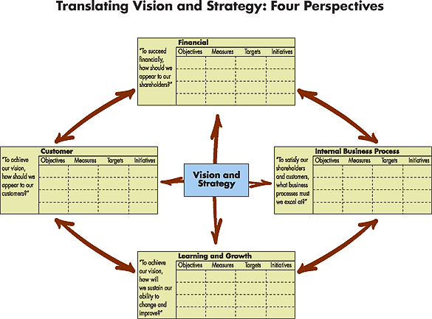

Slide 10
Thank you

